Slide 1
A Level Art & Design – Summer Project
Learning Objectives:
To know the 4 A Level Assessment Objectives.
To be able to produce 4 A3 pages of work, 1 related to each Assessment Objective.
Assessment Objective 1 – DEVELOP
Develop ideas through sustained and focused investigations informed by contextual and other sources, demonstrating analytical and critical understanding.
Assessment Objective 2 – EXPLORE
Explore and select appropriate resources, media, materials, techniques and processes, reviewing and refining ideas as work develops.
Assessment Objective 3 – RECORD
Record ideas, observations and insights relevant to intentions, reflecting critically on work and progress.
Assessment Objective 4 – PRESENT
Present a personal and meaningful response that realises intentions and, where appropriate, makes connections between visual and other elements.
Think of this as a mini project…
Your A Level Coursework is a ‘Personal Investigation’. AQA want you to use Art as a way to investigate and explore a topic which is personal to you.
Over the summer I want you to think about what that topic might be and begin, through the form of a mini project, to produce work based on the topic you have chosen.
The most effective way to do this is to use the AQA Assessment Objectives to guide you as you create each A3 page of work.
You may use a sketchbook or you can work on lose leaf A3 sheets, the choice is yours. Consider each page carefully because if your standard is high enough, we will hopefully be able to use your work to form parts of your coursework.

Slide 2
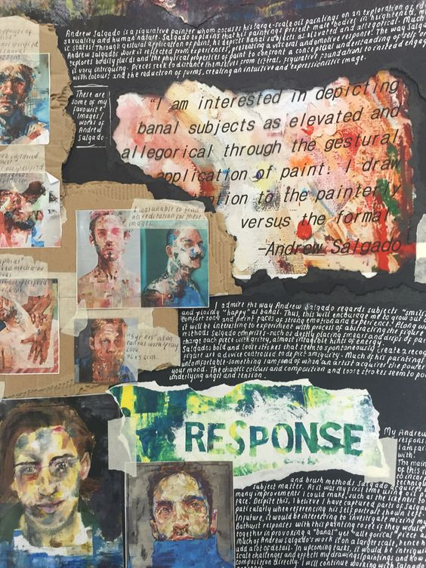
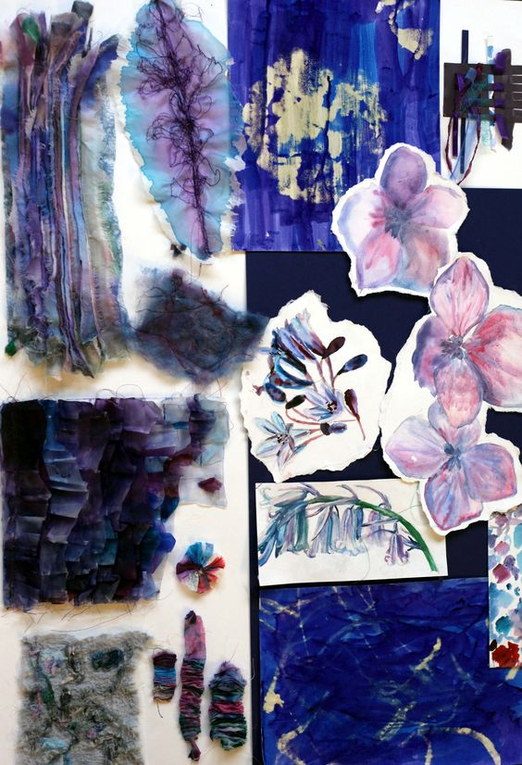
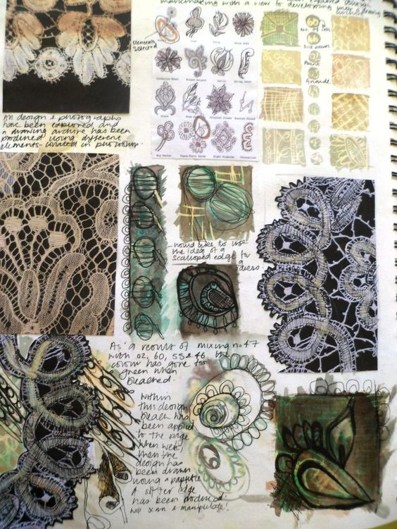
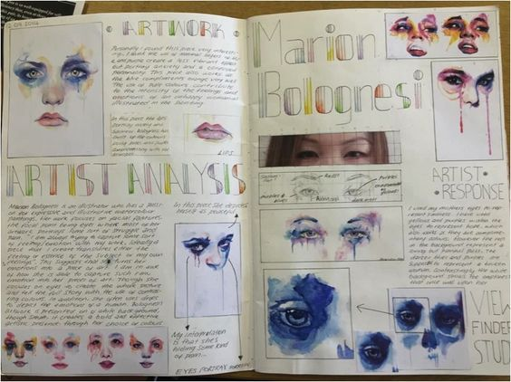
A Level Art & Design – Summer Project
Learning Objectives:
To know the 4 A Level Assessment Objectives.
To be able to produce 4 A3 pages of work, 1 related to each Assessment Objective.
Assessment Objective 1 – DEVELOP
Develop ideas through sustained and focused investigations informed by contextual and other sources, demonstrating analytical and critical understanding.
Assessment Objective 2 – EXPLORE
Explore and select appropriate resources, media, materials, techniques and processes, reviewing and refining ideas as work develops.
Produce an ARTIST STUDY on an artist relevant to the topic you have chosen.
Use the examples below to help you with layout and presentation…
Produce a page of EXPLORATIVE/DEVELOPMENTAL work which uses your artist as an influence and investigates your topic through a wide range of imagery and media.
Use the examples below for inspiration…

Slide 3
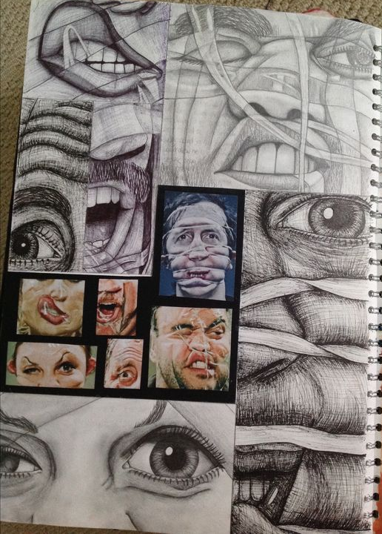
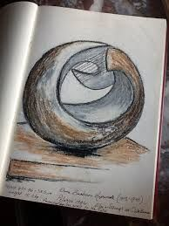
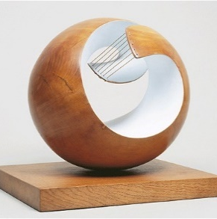
A Level Art & Design – Summer Project
Learning Objectives:
To know the 4 A Level Assessment Objectives.
To be able to produce 4 A3 pages of work, 1 related to each Assessment Objective.
Assessment Objective 3 – RECORD
Record ideas, observations and insights relevant to intentions, reflecting critically on work and progress.
Assessment Objective 4 – PRESENT
Present a personal and meaningful response that realises intentions and, where appropriate, makes connections between visual and other elements.
Produce an OBSERVATIONAL DRAWING of an image you have taken which is relevant to your chosen topic.
REMEMBER to mount up the image you have worked from alongside your drawing so that your observational skills can be assessed.
Produce a FINAL PIECE IDEA which brings together your work on this topic so far.
REMEMBER a final piece idea should clearly show an artist influence and also demonstrate your intentions for use of media.

