Slide 1
GCSE History
Aims of the session:
To ensure you know the GCSE format
To provide you with practical revision techniques
To provide you with strategies to help you support your child at home

Slide 2
Section 1: How GCSE History Works
Exam information

Slide 3
Exam overview
OCR History A: Schools History Project (From 2013)
Two examination papers and one Controlled Assessment Task (CAT)
Paper 1: Unit A594D/14 – Development Study with Germany c.1919-1945 – Depth Study 45%
Paper 2: Unit A955A/21 – Historical Source Investigation: A Study in British History: Public Health in Britain 1800-1914 30%
Unit A953: History Around Us (Warwick Castle CAT) 25%

Slide 4
Structure of Paper 1
The first part of Section A will be on Medicine Through Time. The second part of Section A will be on Crime and Punishment Through Time, but you must ignore this section. Section B will be on Weimar and Nazi Germany.
The first part of Section A consists of two compulsory source questions (worth 7 and 8 marks respectively) and three optional sets of three non-source based questions each (worth 5, 7 and 8 marks respectively). Students must answer all three questions in the set they choose.
Section B consists of three compulsory source questions (worth 7, 6 and 7 marks respectively) and two optional sets of three non-source based questions each (worth 5, 7 and 8 marks respectively). Students must answer all three questions in the set they choose.

Slide 5
Structure of Paper 2
All of the questions on the paper focus on British Public Health, 1800-1914.
You must answer all of the questions on the paper. There will be five questions.
All of the questions will be based on sources.
The types of question change slightly each year, but the most common questions focus on the reliability, utility, typicality and purpose of the sources provided.
In the final question you are always given a statement about British public health between 1800 and 1914. You must explain reasons why you agree and disagree with the statement, using the sources to support your answer. This question is worth 16 marks. You should allow at least 30 minutes to answer this question.

Slide 6
Section 2: Revision Strategies
Ideas to help students master the key skills needed in the History examinations

Slide 7
Contextual Knowledge
Many students find it difficult to remember the amount of specific content that it is necessary to include in their answers. The following ideas are designed to help students with this.

Slide 8
Knowledge Audits
A knowledge audit is a useful tool for identifying exactly what you do and do not know in preparation for the examinations. I have uploaded a knowledge audit for each of the three units onto ‘Show My Homework’. The idea is that you ‘RAG’ (red, amber, green) each topic to identify the areas you need to focus on for your revision. You can then repeat the process every few weeks, in order to check your progress and refine your revision plan.
Topic | Understanding
Prehistoric beliefs about the causes of illness
Prehistoric treatments
Ancient Egyptian beliefs about the causes of illness
Ancient Egyptian treatments
Ancient Egyptian methods of disease prevention
Four Humours
Importance of Hippocrates
Asclepeia
Importance of Galen
Ancient Roman public health
Impact of Christianity and Islam on medieval medical development
Medieval hospitals and healers
Medieval knowledge of the human body and causes of disease
Medieval treatments
Medieval surgery

Slide 9
Revision Booklets
I have made a revision booklet for each of the topics covered, including a booklet that has a step-by-step guide to how to answer each of the most commonly asked examination questions. The full set of six booklets is available from Reprographics for £4.50. There are also some available to buy straight after this session.
The revision booklets can be used in a variety of ways, such as:

Slide 10
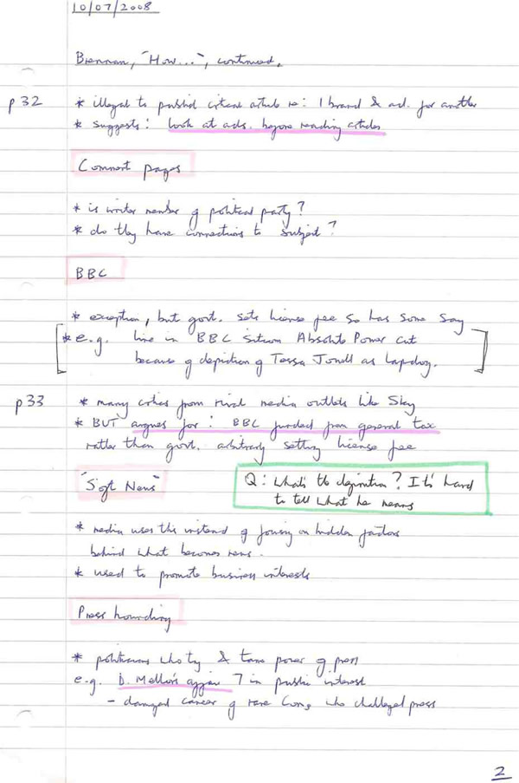
Condensing notes
Make notes on each topic in the booklet, then condense your notes down to the key points, then condense them again to the key words.

Slide 11
CORNELL NOTES
An electronic copy of the sheet is on ‘Show My Homework’.

Slide 12
Individuals cards
I have uploaded sets of cards to ‘Show My Homework’ that help students to collate key information about each individual covered in the Public Health and Germany units. I will be making Medicine cards shortly. The revision booklets can be used to access the information necessary to complete the cards. An example of one of the Germany cards is below.

Slide 13
Timelines
Timelines are an excellent way for students to get to grips with the chronology for the units. I have uploaded information onto ‘Show My Homework’ that will help students to create their own timeline for each of the units, which can be used in conjunction with the revision booklets. Many students find it useful to stick these above their desks/in their revision areas and refer to them whilst revising particular topics.
In addition, timelines can be colour coded and annotated to show other important information, such as the different factors involved in a development (for the Medicine unit) and examples of change, continuity and progress.

Slide 14
Q&A cards
Question and answer cards are a really versatile revision tool. The process of creating the cards is useful revision in itself, but they can also be used to enable others (such as a parent/carer) to test you on your knowledge. The revision booklets can be used to find information with which to make the cards.
Alternatively, you could set out some of the cards on a table with the questions facing up. Ask yourself each question in turn, then check the answer on the reverse. If you got the answer right, place the card with the answer facing up. Repeat the process with all of the cards, then go back and ask yourself the questions again that you got wrong the first time.

Slide 15
Dynamic Learning
The school has purchased access to a website that has a range of activities on the Medicine Through Time unit. The log in details are on ‘Show My Homework’.

Slide 16
Source-based Questions
Over half of the questions on the examinations papers combined are source-based questions, so it is vital that students have good source analysis skills.

Slide 17
‘ASK’ System
The system of source analysis we use with students is ‘ASK’, which stands for Attribution, Source, Knowledge. We encourage students to follow the system with each source before they read the question, then decide which parts of their analysis are relevant to that specific questions.
Attribution – the caption that is found underneath the source. This tells
you essential information, such as where the source is
from and when it was published. The attribution of a
source can be used to work out its purpose.
Source – what is happening in the source itself (the content)? What does
the image show? What does the text say?
Knowledge – what contextual knowledge do you have that relates to
the content of the source?

Slide 18
Knowledge – most factory owners who built model villages did so partly to help their workers, but also so they had a firmer control over them. Many people at the time believed in primary and secondary poverty.
Source E
It would not do you much good if you send it [money] down your throats in the form of bottles of whisky, bags of sweets, or fat geese at Christmas. On the other hand, if you leave the money with me, I shall use it to provide for you everything that makes life pleasant – nice houses, comfortable homes, and healthy recreation.
William Lever addressing his workers in Port Sunlight, 1903.
Source – The source shows Lever telling his workers that they cannot be trusted to spend their wages on sensible items, so they should allow Lever to spend the money for them.
Attribution – William Lever was a philanthropist and joint owner of the Lever Brothers company. Port Sunlight was a model village built by Lever for his workers to live in. The source is a speech made by Lever to his workers, so it will only say what he wants his workers to hear.

Slide 19
Source analysis template

Slide 20
The 16 mark question
Step 1: Use contextual knowledge to explain why the statement is correct.
Step 2: Use the sources to support your contextual knowledge.
Step 3: Use contextual knowledge to explain why the statement is incorrect.
Step 4: Use the sources to support your contextual knowledge.
Step 5: Add a conclusion that comes to an overall judgement about ‘how
far’ and support it with evidence.

Slide 21
16 mark question example

Slide 22
Top Tips for Paper 2 Success
Refer to both details from
the source(s) AND your own
knowledge in EVERY answer.
EXPLAIN HOW details from
the source(s) and contextual knowledge
support your answer.
Explain both sides of the
argument in your answers to
‘how’ and ‘how far’ questions,
but NOT for any other
type of question.
16 mark question – mostly based on
contextual knowledge, but you must
use most of the sources to support
your answer.
For ‘how typical’ questions,
you must explain why the source is
and is not typical AND why an
historian would and would
not be surprised by it.
Use SPECIFIC contextual
knowledge only.
Be careful with dates – do not say a
source is about a development that
happened AFTER the source was made.

Slide 23
Access to sources
A wide range of sources is available on the past examination papers. I have put a link to the relevant pages on ‘Show My Homework’. The more you practise analysing sources, the better you will get!

Slide 24
Classtools.net
This website has been designed primarily for teachers to create learning resources, but it is also great for students to use as a revision tool. It enables students to create electronic versions of tools such as:
Timelines
Diagrams
Source galleries
Linking jigsaws
Living graphs
Essay plans
Diamond 9s (for prioritising key features, factors, etc.)
Facebook profiles for key individuals
Puzzles and games for your friends to play.
I have uploaded the link to ‘Show My Homework’.

Slide 25
Section 3: General hints and tips

Slide 26
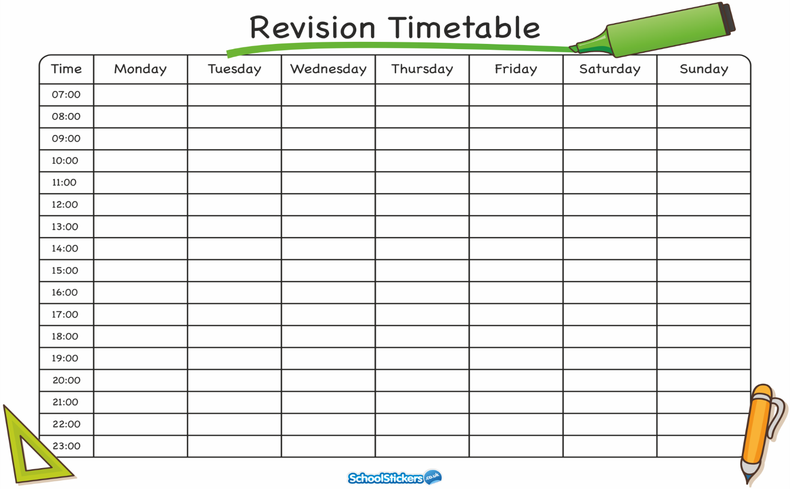
Revision Timetable
It is important to plan your revision carefully for each subject, making sure that you focus your revision on what you don’t know, rather than what you do know.
However, it is also important to take regular breaks.
And YES, you should start revising NOW, if you haven’t done so already!

Slide 27
Revision sessions
After school revision sessions will be starting after half-term. These sessions will run from 3.20 pm until 4.20 pm every Wednesday in H3.
I will also be running lunch revision sessions after half-term. These will be for invited students only initially, but will be open to all from January.

